Slide 1
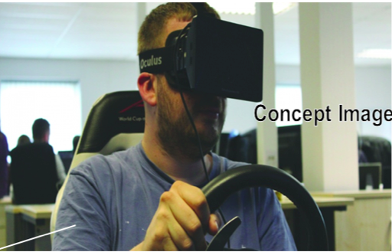
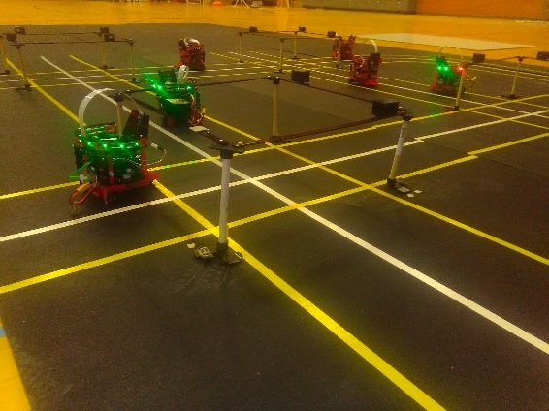



CHARTOPOLIS: A testbed for driver interaction with driverless cars
Spring Berman², Nancy Cooke¹, Mustafa Demir¹,
Ruben Gameros², Sterling Martin¹, Taylor Reagan¹,
and Rakshith Subramanyam²
Human Systems Engineering, School for Engineering of Matter, The Polytechnic School¹ Transport & Energy (SEMTE)²
Center for Human, Artificial Intelligence, and Robot Teaming (CHART)

Slide 2
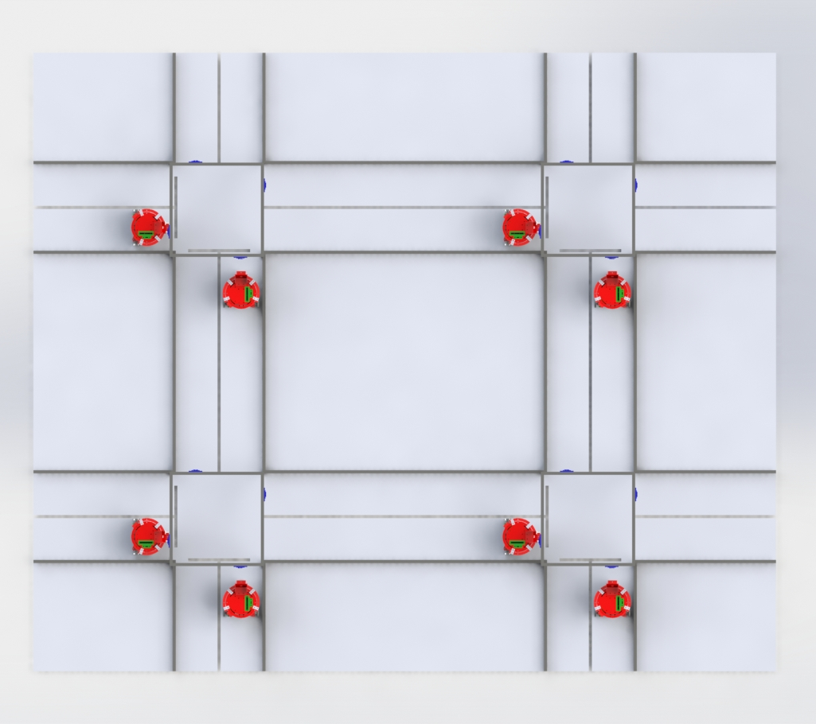
Objectives of Testbed Development
Simulate conditions and challenges similar to those experienced by full-size autonomous vehicles (AVs)
Study risks of driver-AV interactions and ways to mitigate these risks
Study psychological effects of AVs on human drivers
Study effects of increasingly intelligent infrastructure on collision ratios
Investigate capabilities and costs necessary to achieve significant gains in traffic safety and efficiency
CHARTOPOLIS: A testbed for driver interaction with driverless cars
Center for Human, Artificial Intelligence, and Robot Teaming (CHART)
Notes:
Human drivers now often share the road with driverless vehicles, and this situation is likely to continue until all vehicles are driverless. The interactions between drivers and driverless cars can result in hazardous scenarios due to human driving patterns and driver distrust of autonomous vehicle technology. Driverless cars display less variability in driving patterns than human drivers, and the differences sometimes surprise the human driver and can cause accidents. For instance, driverless cars tend to get rear-ended by drivers at yellow lights when the driverless vehicle slows down and the driver behind it speeds up. Researchers at the new Arizona State University Center for Human, Artificial Intelligence, and Robot Teaming (CHART) are developing a testbed called CHARTOPOLIS to investigate the risks that arise from interactions between human-driven and driverless vehicles in a safe, controlled environment, with the ultimate goal of mitigating those risks.

Slide 3
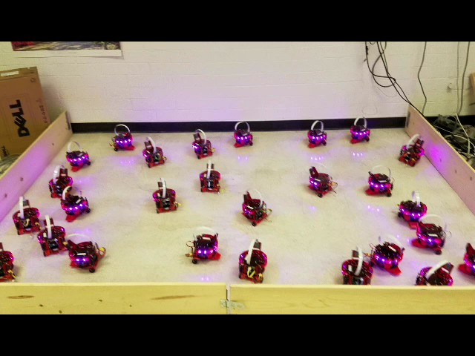
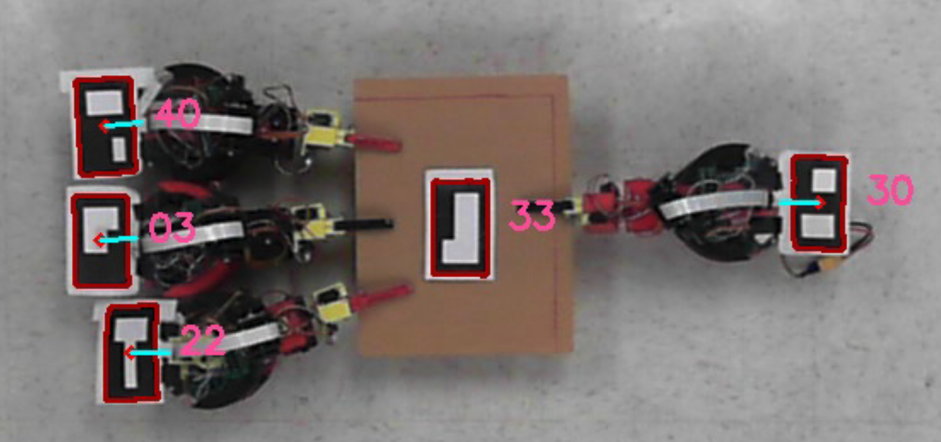
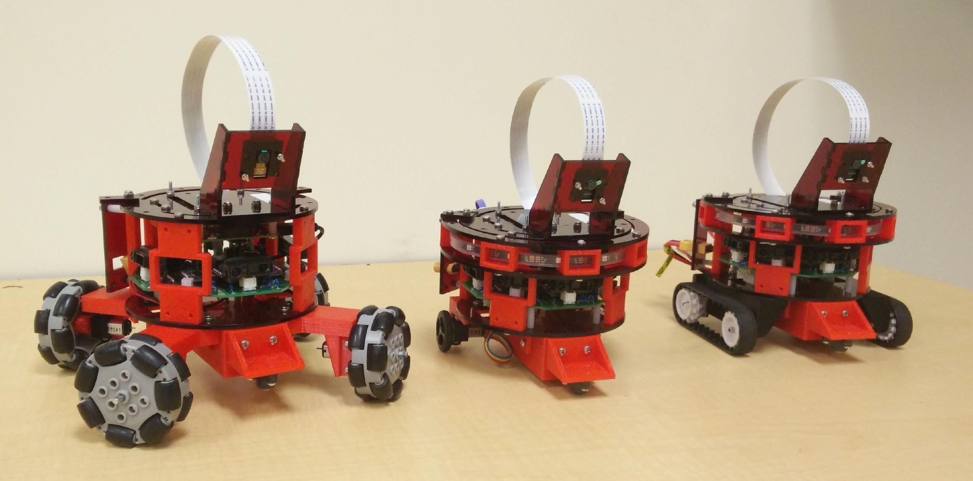
Swarm Robotic Platform: Pheeno
Sean Wilson, Ruben Gameros, et al., IEEE Robotics and Automation Letters 2016; Sean Wilson, Ph.D. thesis, ASU 2017
https://acslaboratory.github.io/
http://wiki.ros.org/pheeno_ros
Autonomous Collective Systems Laboratory YouTube channel
Code, Design Files,
User Guides:
CHARTOPOLIS: A testbed for driver interaction with driverless cars
Center for Human, Artificial Intelligence, and Robot Teaming (CHART)
Notes:
My research group has developed a new open-source, open-hardware robot called “Pheeno” [R1, R2]. Pheeno is a small, low-cost autonomous mobile robot that is designed for multi-robot research and education. The robot is constructed from commercially available components, including low-cost processors, an array of basic sensors, and 3D printing plastic filament. Pheeno’s capabilities include vision­based object detection, collision avoidance, accurate navigation, signaling with LEDs, and wireless communication. Users can modify Pheeno for their applications by designing custom modules and drivetrains (Fig. 1) that attach to its core module (~$260 cost of parts). My group has created a detachable 3-degree-of-freedom manipulator arm that allows Pheeno to grasp, rotate, and lift objects individually or cooperatively (Fig. 2 and Fig. 3). These capabilities are unique for a robot of its small size and low cost. Pheeno is compatible with the Robot Operating System (ROS), an open-source software framework for robotics development. My group is creating ROS software packages for running both 3D simulations and physical experiments with multiple Pheeno robots.

Slide 4
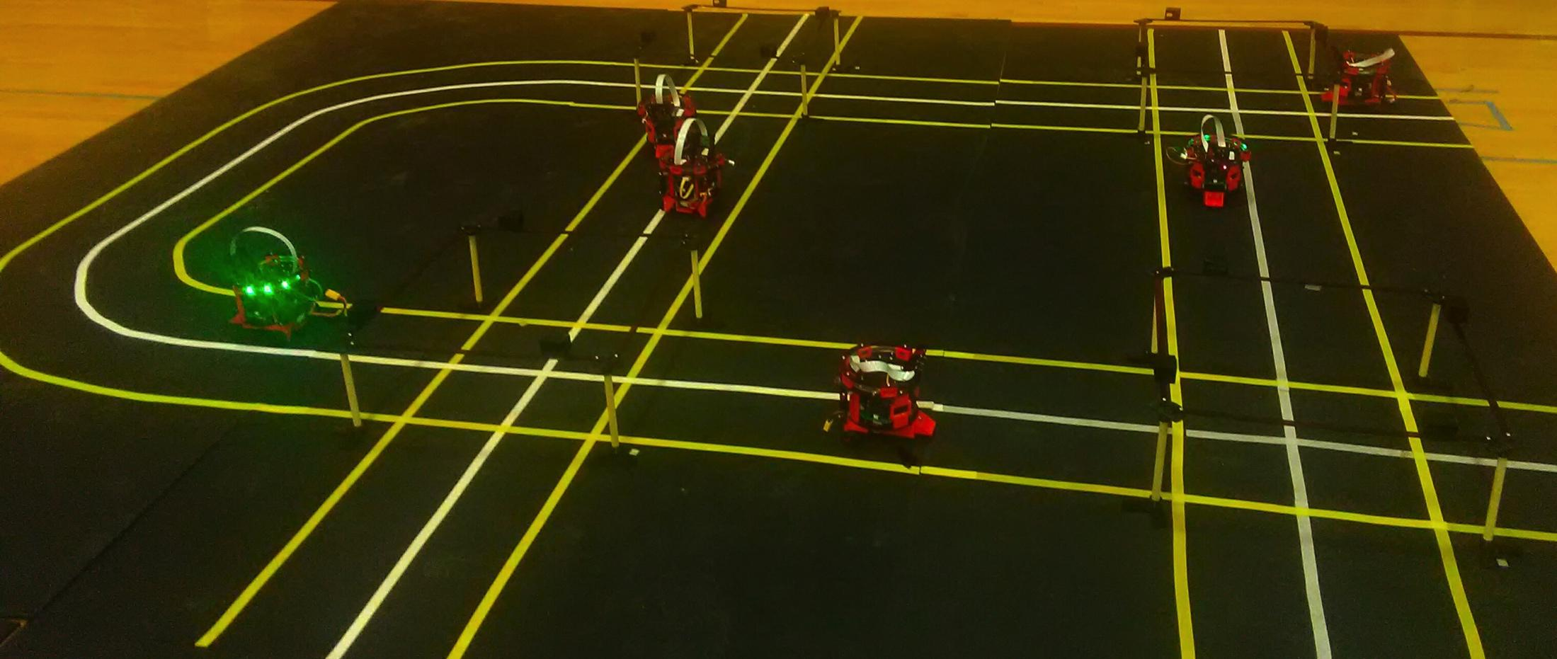
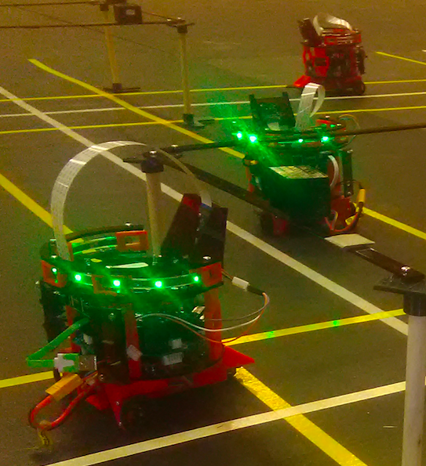
CHARTOPOLIS Components
Robots emulate manually-driven and autonomous vehicles
Infrared sensors: enable awareness of obstacles and other vehicles
Forward-facing camera: identifies traffic signals, aids in lane following, detects the state of other vehicles
LED ring: signals state of the vehicle
CHARTOPOLIS: A testbed for driver interaction with driverless cars
Center for Human, Artificial Intelligence, and Robot Teaming (CHART)
Notes:
Although Pheeno is a differential-drive platform, a model was implemented that allows for the mimicking of four-wheeled vehicle motion.
Navigation is carried out using sensor fusion of wheel encoders, camera and infrared data.
consists of an expandable 12’x20’ grid system, complete with small customizable robotic vehicles called Pheeno
During experiments, robots will switch between standard mode and rogue mode where individual robots will violate traffic rules. The rate of switching to rogue mode and the duration of rogue mode will each be parameters that can be varied.
Gamepad: enables wireless control of “manually-driven” vehicles

Slide 5
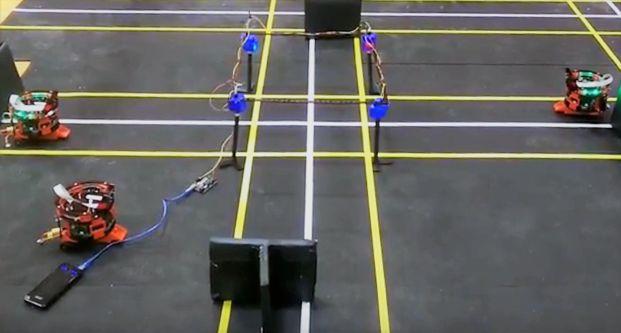
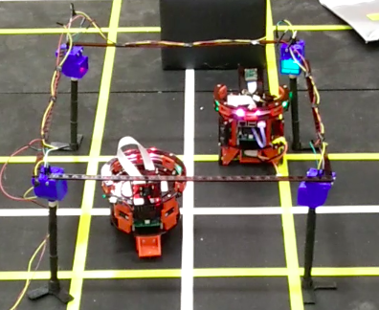
CHARTOPOLIS Components
Intersections with “smart” traffic signals
Each has a separate controller and 4 traffic signals
Monitor velocities of approaching vehicles
Can identify “rogue” robots that don’t follow traffic signals or speed limits
Can alter traffic signals to prevent vehicle collisions
CHARTOPOLIS: A testbed for driver interaction with driverless cars
Center for Human, Artificial Intelligence, and Robot Teaming (CHART)

Slide 6
Planned Testbed Experiments
Mixed environment of AVs & multiple manually-driven vehicles
Human driver views environment through robot’s onboard camera from a first-person-view terminal
Controllers for intersections and autonomous robots will be independently designed for different test conditions
Can drivers identify AVs based on their driving behavior?
How will AVs emotionally affect human drivers on the road?
CHARTOPOLIS: A testbed for driver interaction with driverless cars
Center for Human, Artificial Intelligence, and Robot Teaming (CHART)
Notes:
We plan to conduct experiments with multiple human participants in which vehicles are identified (or not) as driverless, in order to examine the effects of driver expectations on driving behavior. In additional studies, we plan to examine driver frustration associated with driverless cars and its connection to poor driving behavior.
Groups of autonomous robots will share the testbed roads with robots that are individually controlled by human operators, who will view the environment through the robot’s onboard camera from a first-person-view terminal with a steering wheel and pedal controls. Both remote-controlled and autonomous units feature the same hardware, and different numbers of both types of units will be used in experiments.

